Slide 1

CSCI321 – Final Year Project Two Factor Authentication
KOH HONG WEI
ADLER CHUA HAN MING
ONG WEI HAO
SUPERVIOR: DR. TA NGUYEN BINH DUONG

Slide 2
Content Page
Topic
Product Overview
Objective
Product
Learning
Market Research
Product Features
Security Aspect
Development tools and Methodology
Project Time Line
Future Enhancement
Prototype Demonstration

Slide 3
Topic
What is Two-Factor Authentication?
referred to as a 2 step verification
factors of the authentication can be one the following:
something you know (passwords)
something you have (OTP token)
something you are (biometrics)

Slide 4
Product Overview
go2FactorAuthentication is a program that keep files secure using a two factor authentication algorithm.
go2FactorAuthentication uses the password and mobile of the user to securely lock/unlock the files.
Using the mobile application, users log-in and scan the QR code to produce a unique OTP.

Slide 5
Product Objective
This product aims to provide users with the following:
Safe and easy to use program
Secure files from unauthorized usage
Two-factor authentication to access files

Slide 6
Learning Objective
Formulating realistic work plans & procedures
Securing communications between devices
Android programming
Java GUI
Database design & management

Slide 7
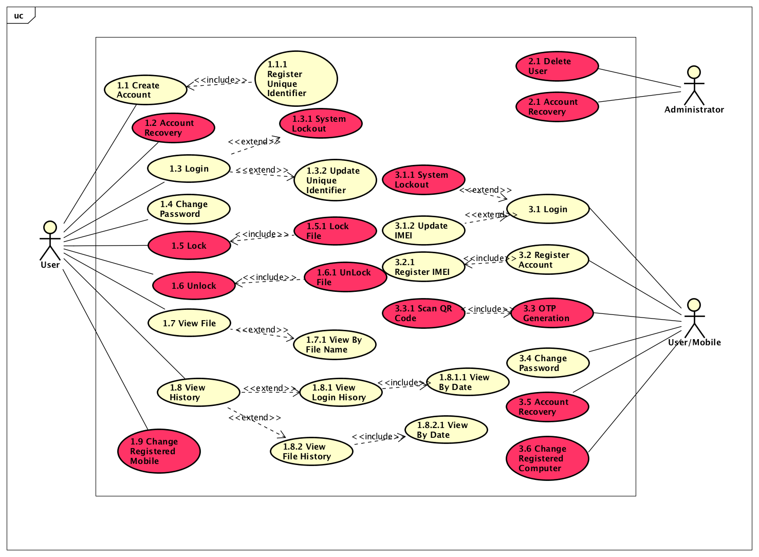
Product Feature

Slide 8
Security Aspect
Server Communications
SSL/TLS (interception, eavesdropping)
Database (SQL injection prevention)
Disciplined programming
SQL rand
Input validation
Blind variables
QR Generation
Information stored in the QR code is encrypted.
Only user with registered mobile can decrypt through the go2FactorAuthentication Mobile Application.

Slide 9
Development Tools and Methodology
Rational Unified Process is an iterative software development framework. It consists of 4 main stages:
Inception
In this phase, the scope of the project is defined.
Requirements are gathered.
Mitigate the key risk items identified through analysis.
Elaboration
Develop detailed design of the system with diagram aids (use case diagram, activity diagram etc)
Construction
In this phase, the actual product is being developed.
Transition
Primary objective is to transit from development phase into production, making it ready for the market. This phase includes testing the system and providing training to its user.

Slide 10
Proposed Project Time Line
0 | Full Project Time Line
1 | Inception Phase 1
1.1 | Project Proposal
2 | Inception Phase 2
2.1 | Update Project Proposal
3 | Elaboration Phase 1
3.1 | Project Software Requirement Specification
3.1.1 | Use-Case Diagram
3.1.2 | Activity Diagram
3.1.3 | Sequence Diagram
3.1.4 | Use Case Textual Description
3.2 | Project Database Design Document
3.2.1 | Object Diagram
3.2.2 | Conceptual Diagram
3.2.3 | Data Dictionaries
4 | Elaboration Phase 2
4.1 | Project Software Requirement Specification
4.1.1 | Use-Case Diagram
4.1.2 | Activity Diagram
4.1.3 | Sequence Diagram
4.1.4 | Use Case Textual Description
4.2 | Project Database Design Document
4.2.1 | Object Diagram
4.2.2 | Conceptual Diagram
4.2.3 | Data Dictionaries
4.3 | User Manual
5 | Construction Phase 1
5.1 | Product Prototype
5.1.1 | Desktop Application
5.1.1.1 | Desktop(User)
5.1.1.2 | Desktop(Admin)
5.1.2 | Mobile Application
5.1.2.1 | Mobile(User)
5.1.2.2 | Mobile(Admin)
6 | Construction Phase 2
6.1 | Desktop Application
6.1.1 | Desktop(User)
6.1.2 | Desktop(Admin)
6.2 | Mobile Application
6.2.1 | Mobile(User)
6.2.2 | Mobile(Admin)
7 | Transition Phase 1
7.1 | Test-Case Derivation
7.2 | Usability Test
7.3 | Penetration Test
8 | Transition Phase 2
8.2 | Usability Test
8.3 | Penetration Test

Slide 11
Future Enhancement
Account Recovery
Changing of registered Mobile/ Computer

Slide 12
Prototype Demonstration

Slide 13
Question & Answer

